Slide 1

How do Organisms
Reproduce?
Menstruation
Reproductive health and sexually transmitted diseases

Slide 2
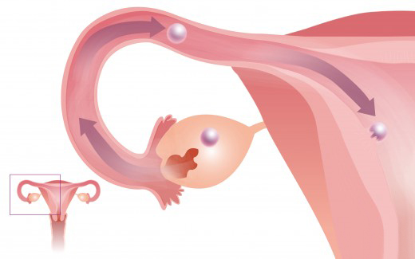

What happens when the Egg is not Fertilized?
If the egg is not fertilised, it lives for about one day.

Slide 3

What happens when the Egg is not Fertilized?
Since the ovary releases one egg every month, the uterus also prepares itself every month to receive a fertilised egg.
Thus its lining becomes thick and spongy.

Slide 4
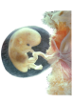
What happens when the Egg is not Fertilized?
This would be required for nourishing the embryo if fertilisation had taken place.

Slide 5
What happens when the Egg is not Fertilized?
Now, however, this lining is not needed any longer.
So, the lining slowly breaks and comes out through the vagina as blood and mucous.

Slide 6
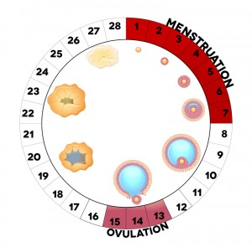
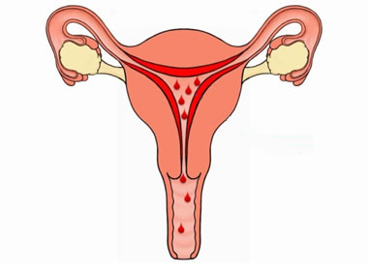
What happens when the Egg is not Fertilized?
This cycle takes place roughly every month and is known as
Menstruation.
It usually lasts for about two to eight days.

Slide 7
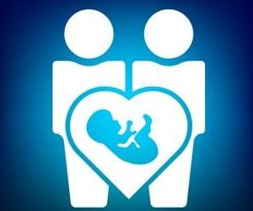
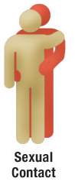

Reproductive health
Since the sexual act is a very intimate connection of bodies, it is not surprising that many diseases can be sexually transmitted.

Slide 8
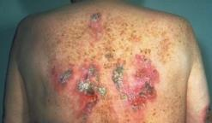
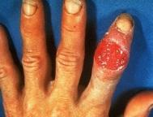
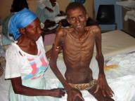
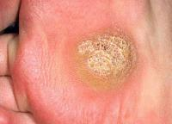
Reproductive health
Diseases which are spread by sexual contact with an infected person
Sexually Transmitted Diseases (STDs)
Gonorrhoea
Syphilis
AIDS
Warts
Bacterial
Viral

Slide 9

Reproductive health
Is it possible to prevent the transmission of such diseases during the sexual act?
Yes

Slide 10

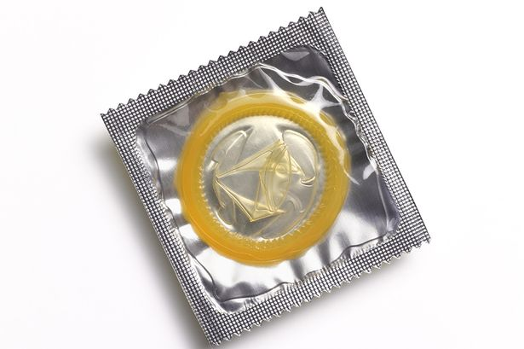
Reproductive health
Using a covering, called a condom, for the penis during sex helps to prevent transmission of many of these infections to some extent.

Slide 11
Thank You

